Slide 1
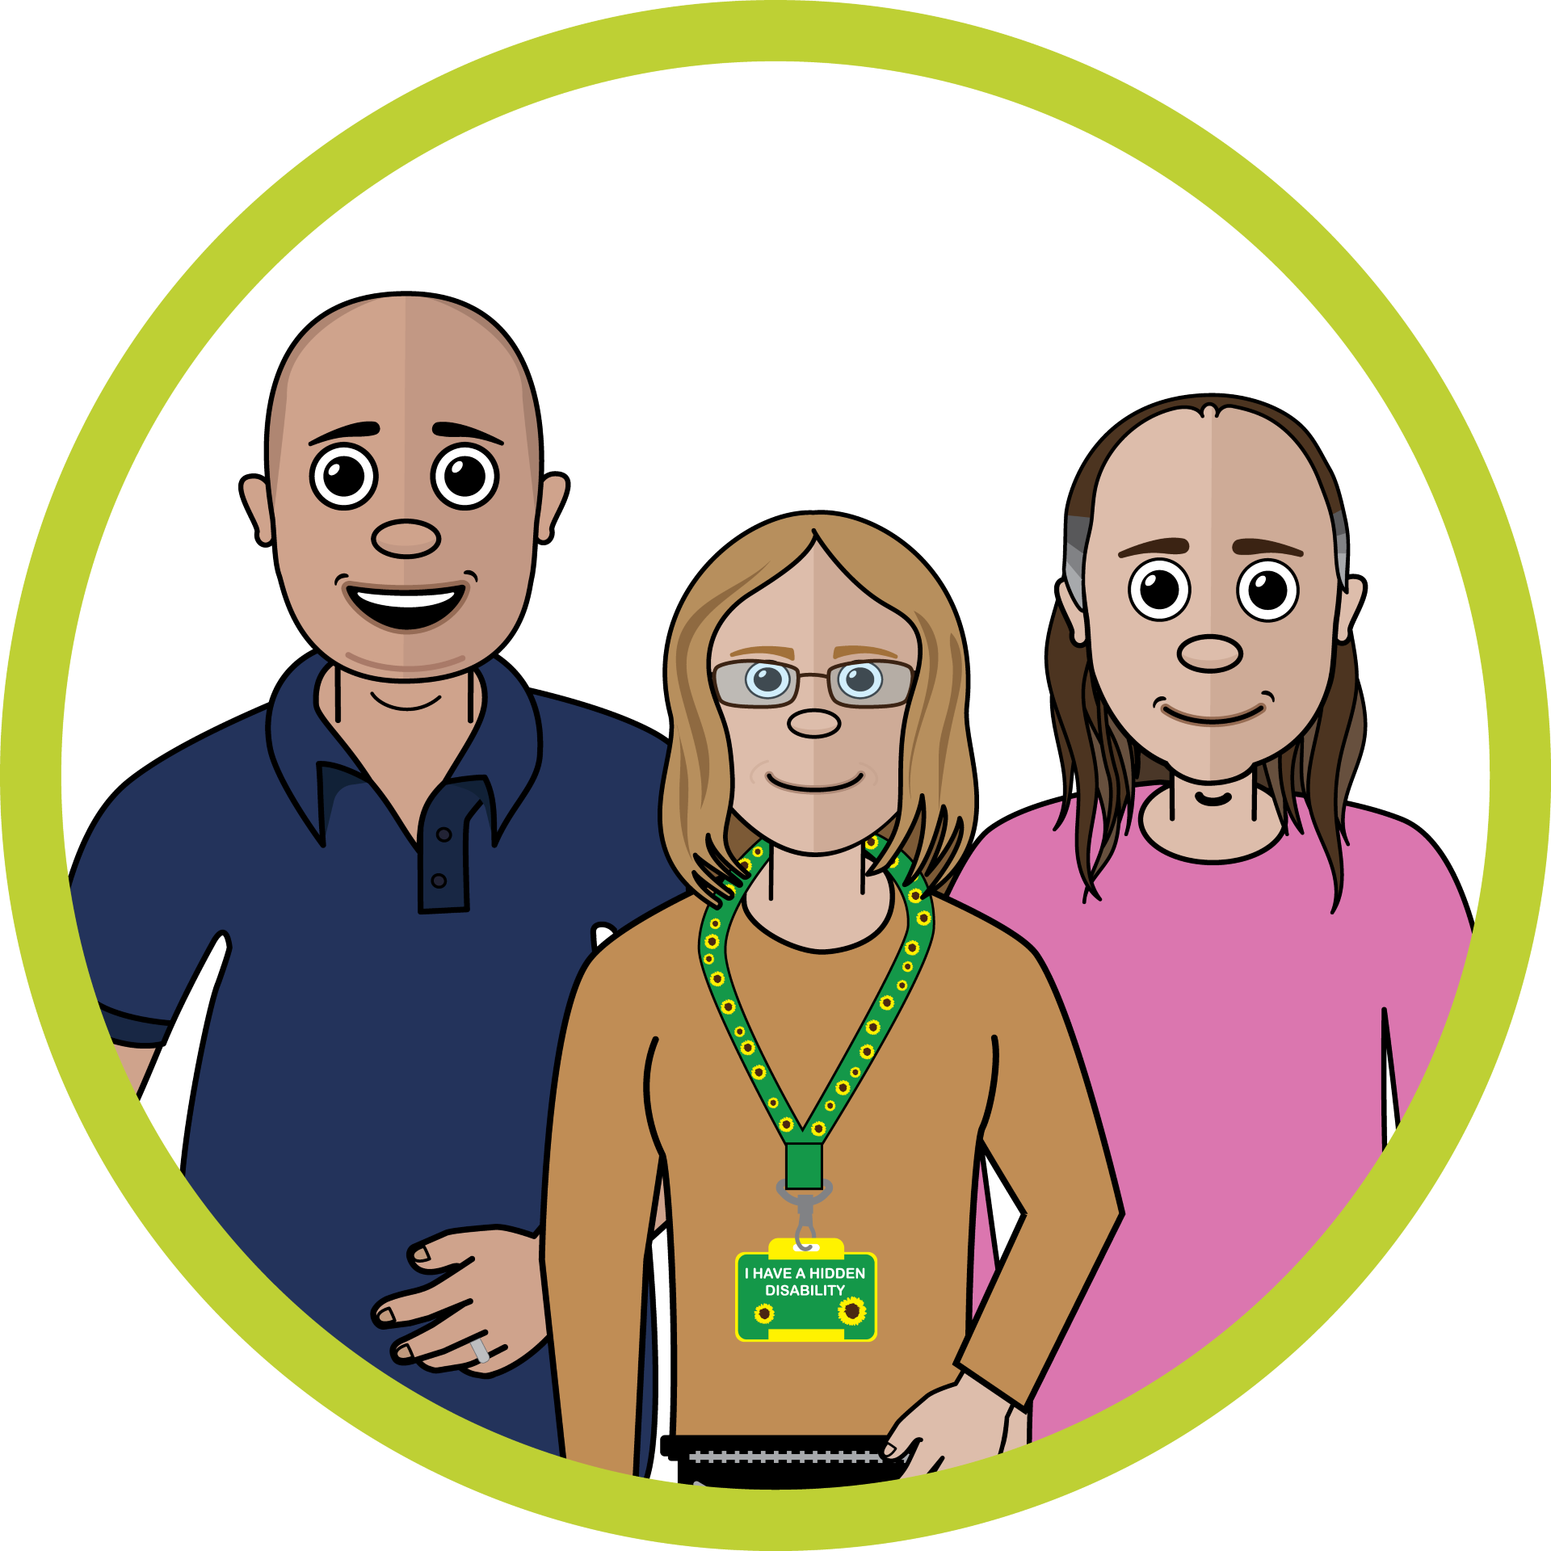
Talking About Dying
Coproduced by people with learning disabilities

Slide 2
Course Aims
Supporting people with learning disabilities to live their best life
Why should we Talk About Dying
How should we Talk About Dying
When Should we Talk About Dying
Who Should Talk About Dying
Where should we Talk About Dying

Slide 3

Talking About Dying
Introduction Video
https://www.youtube.com/watch?v=zu9SbFHuGEk&t=3s

Slide 4

Living Your Best Life
Describe your best day…
What would you do?

Slide 5
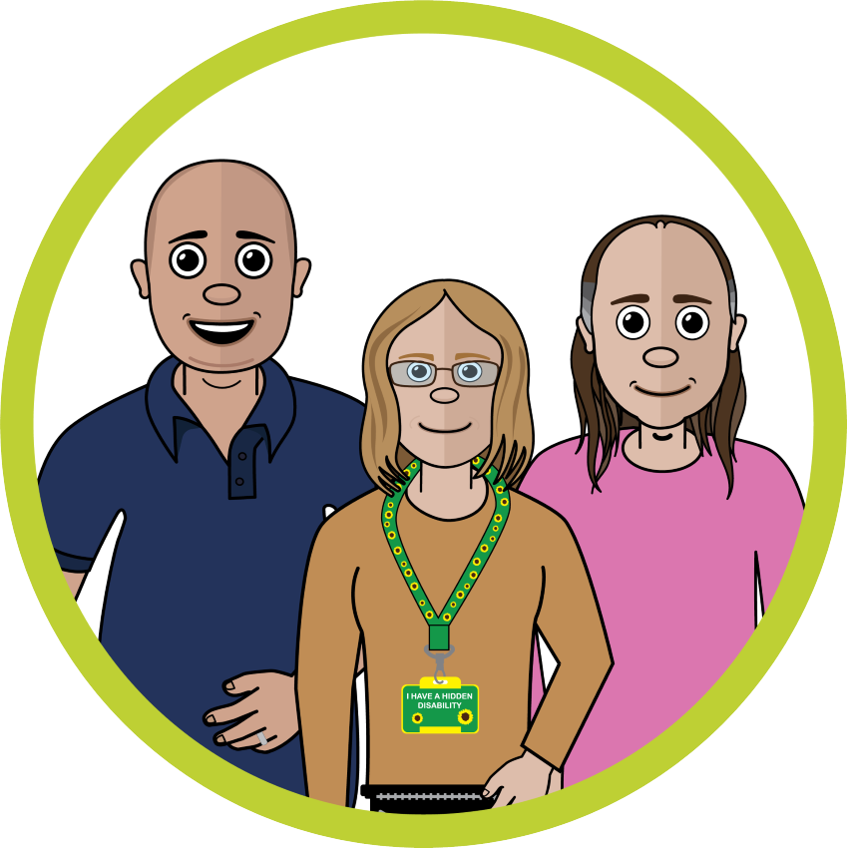
Living Your Best Life
Think about…
The people who are important to you
That special place
What means the most to you
Are there things you still want to do

Slide 6

Why to Talk About Dying https://www.youtube.com/watch?v=qcMKcpPdgwY
We should get to choose what we want…

Slide 7
Why should we talk about dying
Think about…
What gets in the way?
How does it make you feel?
Is this something you’ve do?
Action point

Slide 8
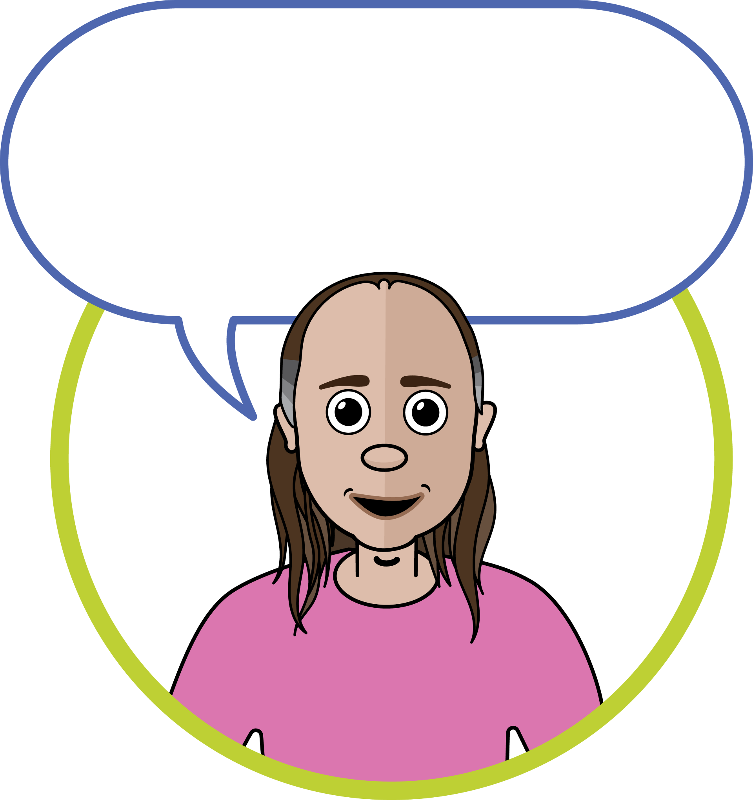
How to Talk About Dying https://www.youtube.com/watch?v=lga8PPIa5n8
Start with what’s important in life…

Slide 9
How can we Talk About Dying?
Where to start?
How do we find the words?
What if the person doesn’t use words?
Getting started…
Talking points… celebrity death, a pet, a soap storyline…

Slide 10
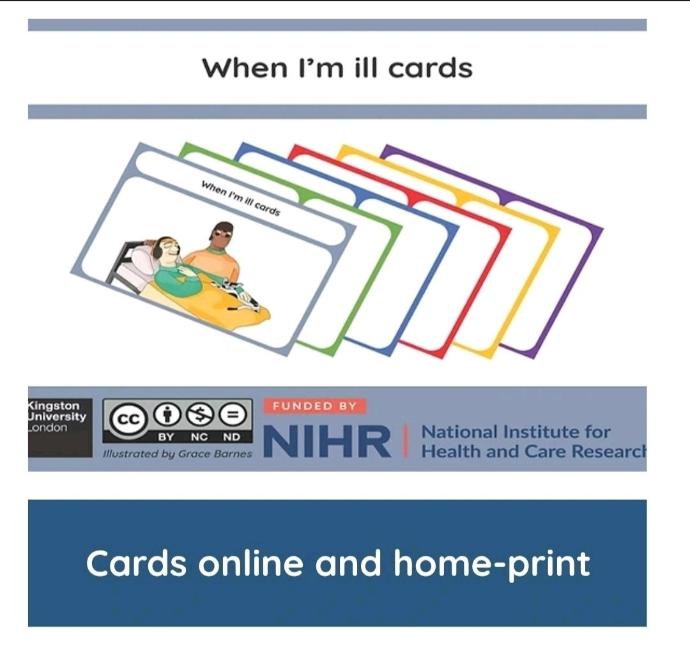
The Victoria & Stewart Project
Finding the best ways to help
people with learning disabilities
plan for the end of their life…
https://www.victoriaandstuart.com/

Slide 11
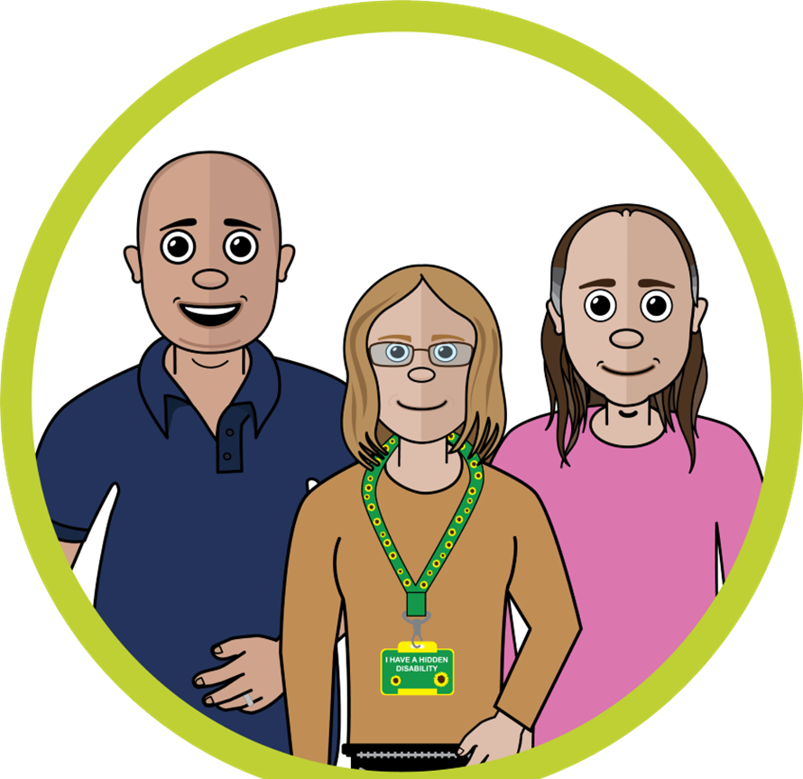
No Barrier Here
A unique and innovative approach to advance care planning for people and communities who experience inequity accessing palliative and end of life care…
https://www.nobarriershere.org/

Slide 12
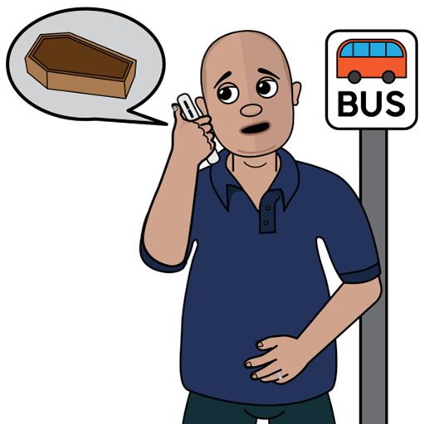
Lewis was given bad news over the phone whilst in the bus station
How could this have been done differently?
Social Stories

Slide 13
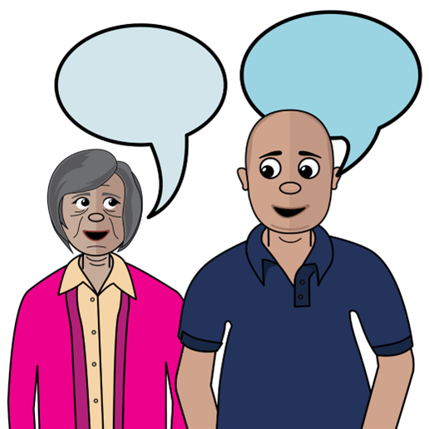
How could this have been done differently?
Social Stories

Slide 14

There’s a thinker and a Listener
It uses words and pictures
It helps to think about things
It helps with important decisions
Talking mats
What is Talking Mats?

Slide 15
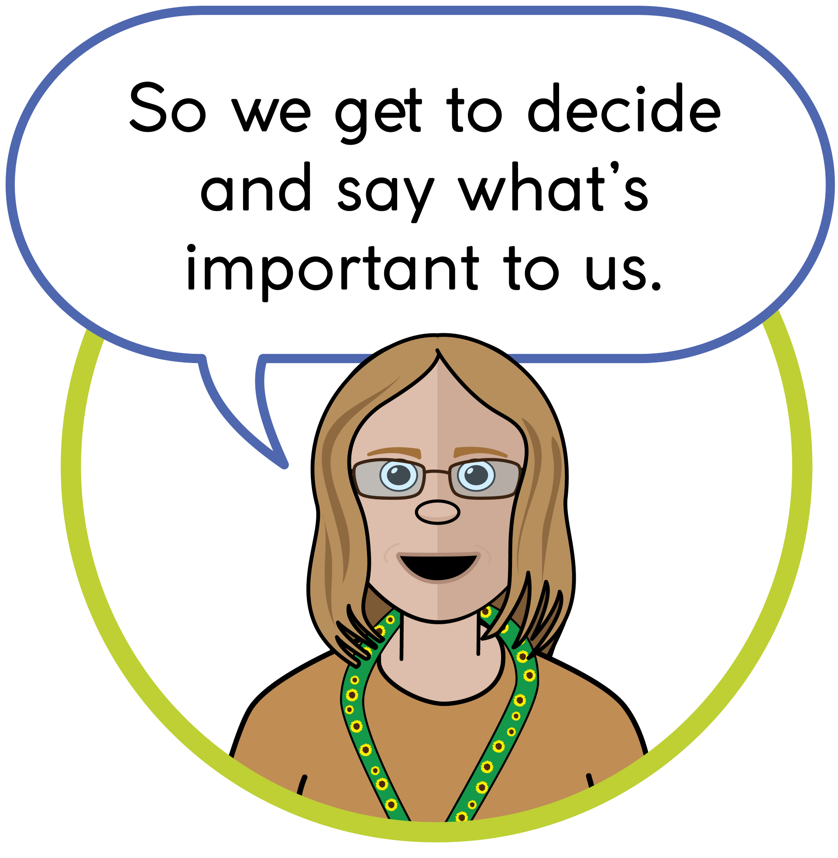
Future Wishes
Planning ahead
Getting it right
https://www.learningdisabilityservice-leeds.nhs.uk/wp-content/uploads/2024/10/Advance-care-plan-booklet-easy-read-2024-fillable.pdf

Slide 16
Where to Talk About Dying https://www.youtube.com/watch?v=EmWYUFjk1gY
The place that’s best for the person…

Slide 17
Where to Talk About Dying
Think about…
Where would you choose?
What would you need to consider?
Action point

Slide 18
When to Talk About Dying https://www.youtube.com/watch?v=0iuq2UJa_V0
Throughout our lives…

Slide 19
When to Talk About Dying?
Think about…
Is there a right time?
What age is the right age?
Is there a wrong time?
Action point

Slide 20
Who should Talk About Dying https://www.youtube.com/watch?v=dHl7aOBF9zQ
We should all talk about dying…

Slide 21
Who should Talk About Dying?
Think about…
Why is it important for people with learning disabilities?
Who should start the conversation?
What if the person doesn’t use words?
Action point

Slide 22
Further Resources
The Victoria and Stewart project
No Barriers Here
Future Wishes

Slide 23
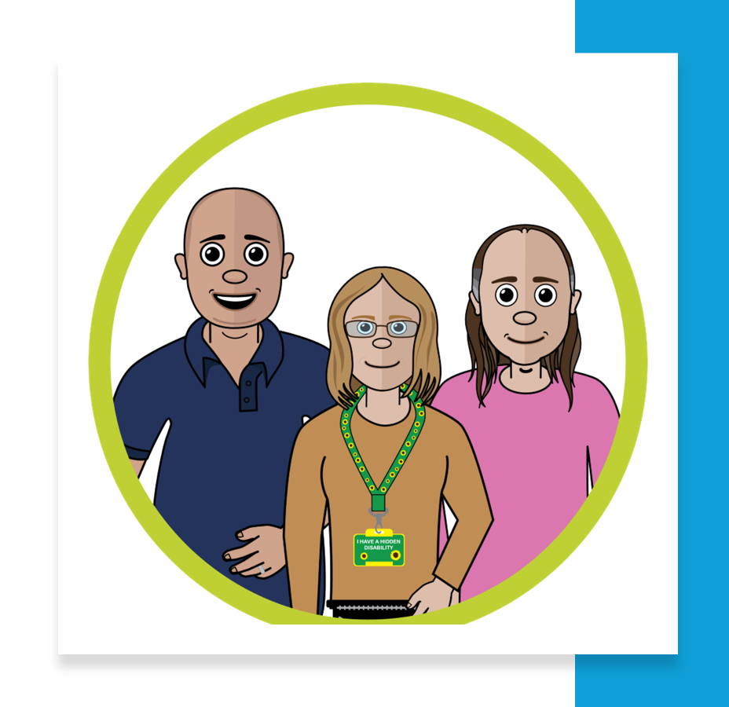
Action Points
Why should we Talk About Dying?
How should we Talk About Dying?
When Should we Talk About Dying?
Who Should Talk About Dying?
Where should we Talk About Dying ?

Slide 24
Talking About Dying
“We need to talk about it, because taking about death will help us live together better.” Dr Kathryn Mannix
“Dying... It affects all of us, so we should talk about it! It can help us feel less worried and alone!” Professor Irene Tuffrey-Wijne

Slide 25

Dying Well Training
Don’t forget to book your place on the Dying Well training…
What is end of life care
What does it involve
Getting it right
POLE
Who can help

